Slide 1
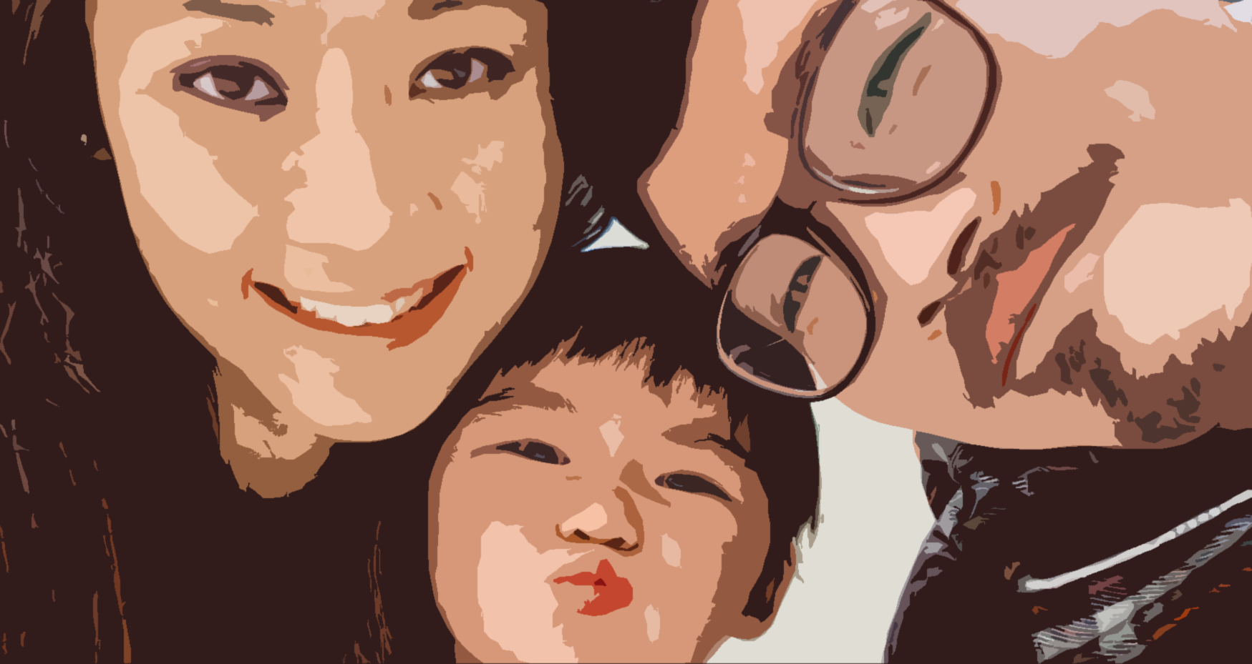
SAFE SPACE TRAINING
Interactive Advocacy for
Healthy Relationships
By Tanya Jones
©2022 INTERACTIVE ADVOCACY LLC ALL RIGHTS RESERVED
WWW.INTERACTIVEADVOCACY.COM

Slide 2
©2022 INTERACTIVE ADVOCACY LLC ALL RIGHTS RESERVED
WWW.INTERACTIVEADVOCACY.COM

